Slide 1
Execution and Comparison of Multiple Sorting Algorithms
By Purnasree Saha, Gurpreet Kaur, Yamini Pathuri, Koundinya Raghava Nerella

Slide 2
Introduction
When there is an array or a list of elements, we need to determine which sorting algorithm will be used to put the elements in the correct order.
The elements in the list or array will continue to execute over and over again until all the elements are sorted.
Sorting methods need to be efficient and fast since data is increasing each day.
Distances from shortest to longest are also determined by different sorting algorithms.
When a list is given, the value will be searched, but if the elements are already sorted in the list, the elements will be found rapidly.
While searching for elements, the elements will be selected based on the relationship of the sequence if it's in increasing or decreasing order.
Comparison operator is used to swap elements in the list.
Time and space complexity determines the efficiencies of sorting algorithms.

Slide 3
Related Work
Sorting Algorithms is an article written by Neelam Yadav and Sangeeta Kumari and it explains the different format of how sorting algorithms work and the pros and cons of each algorithm.
Comparison of parallel sorting algorithms is an article written by Darko Bozidar and Tomaz Dobravec and it introduces the processes of how various sequential and parallel sorting algorithms work.
Threshold Analysis and Comparison of Sequential and Parallel Divide and Conquer Sorting Algorithms is an written by Tinku Singh and Durgesh Kumar Srivastava and it talks about how the steps and techniques of sorting algorithms need to be fast. Also, mentions how parallelism is applied to the sorting techniques.

Slide 4
Merge Sort
An algorithm technique that involves the Divide and Conquer method since the input is split into two parts.
If there are multiple elements in the array, then the array will be divided into multiple subsequences and merge sort will be called recursively.
At first there will be an unsorted list that will be divided into two smaller arrays,.
The arrays will then be solved recursively and then merged into a sorted list.

Slide 5
Quicksort
Quicksort is one of the most efficient sorting algorithms and it also uses the divide and conquer approach.
It can be faster than the merge sort and two to three times faster than the remaining algorithms.
It acts as an internal sorting method, where in the internal memory the data will be sorted.
It selects the pivot element from the array, it can be any element in the array and “partition” the array into two sub-arrays.
The average case time complexity for Quicksort is O(N log(N)).

Slide 6
Bubble Sort:
The bubble sort also known as sinking sort is a simple sorting technique which compares the adjacent elements and swaps if they are not in the right order.
The first pass sorts the heaviest element in the list, the second pass sorts the second heaviest element in the list and so on.
The pass through the list is repeated until the list is sorted.
The time complexity of Bubble sort is O(n2).

Slide 7
Shell Sort:
Shell Sort also known as ‘diminishing increment sort’ is an efficient sorting technique that first sorts the elements far apart from each other and successively reduces the interval between the elements to be sorted.
Shell sort is an improvised version of insertion sort that overcomes the large shifts/swaps as in case of insertion sort.
The key task in shell sort is to determine the gap between the elements that we compare. While there are many ways to do it, the most well known method is to chose the gap by dividing the number of elements in the list by 2 and considering the base value.
The Shell Sort works as an insertion sort when the gap between the elements is ‘1’, however by the time the gap value reaches ‘1’, the farther right minimum values are already shifted to the farther left thus reducing the number of swaps needs to be done unlike insertion sort.
The time complexity of Shell sort with the gap =n/2 method is O(n2).

Slide 8
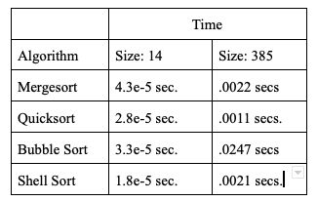
Experimentation and Observation
Sort 2 random lists of world cities in ascending order
Size: 14
Size: 385
Ran all 4 sorting algorithms five times and recorded the average times it took to sort the lists
Observations:
Size 14:
Shell sort is the fastest
Mergesort is the slowest
Size: 385
Quicksort is the fastest
Bubble is the slowest
Bubble sort: As the size increase, the time to run increases

Slide 9
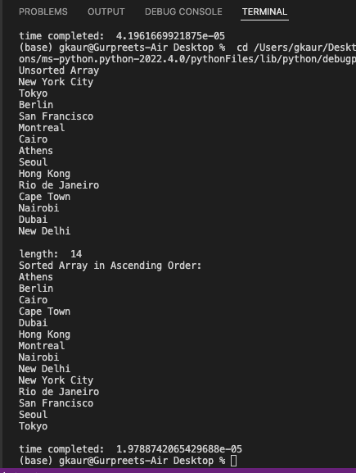
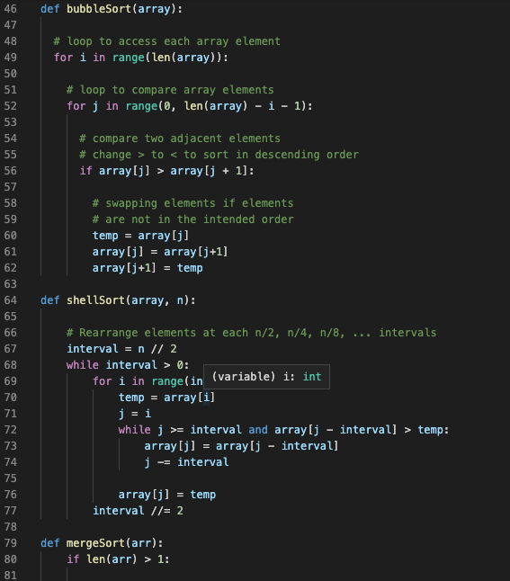
Code and Execution:
Shell Sort
List Size: 14

Slide 10
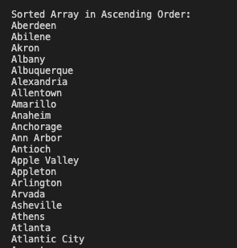
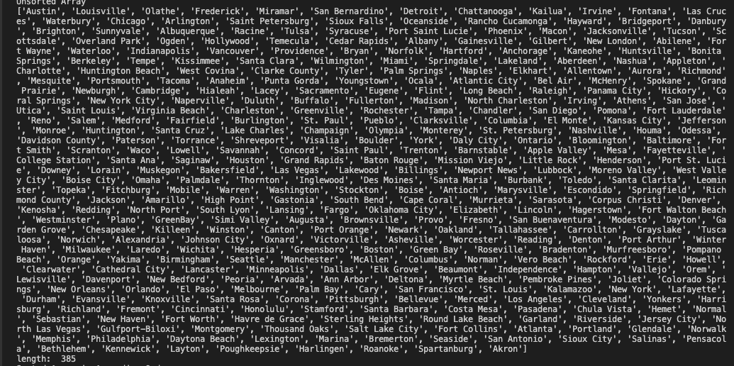
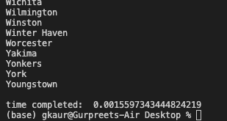
Code and Execution: Shell Sort
List Size: 385

Slide 11
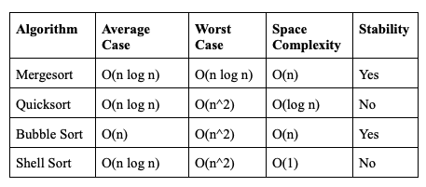
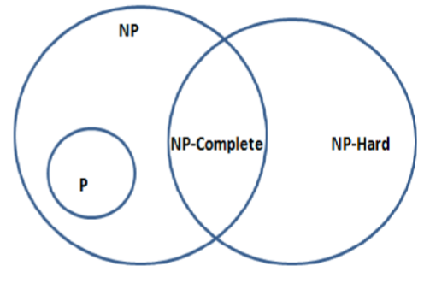
Complexity and NP
Complexity
Mergesort, Quicksort, Bubble sort, and Shell sort are similar
Mergesort has the best worst case
Shell sort has the best space complexity
Stable: Merge sort and Bubble Sort
Sorting Algorithms are Polynomial Time (P) and they are not NP - Complete
Not NP-Complete because there is an efficient solution found in each sorting algorithm
Not NP-hard

Slide 12
Conclusion
Each algorithm was tested to sort a list of cities in ascending order.
List size 14 and list size 385
We found that shell sort ran the fastests while mergesort was the slowest in the list of size 14.
In the list of length 385, quicksort was the fastest while bubble is the slowest.
Mergesort is consistent and performs well regardless of size overall.
We also found that bubble sort runtime increases as the size increases.
Sorting Algorithms are P which means there is an efficient solution in polynomial time.

Slide 13
References
1. Singh Tinku and Srivastava Durgesh Kumar (July 2016) Threshold Analysis and Comparison of Sequential and Parallel Divide and Conquer Sorting Algorithms, International Journal of Computer Applications (0975 – 8887) Volume 145 – No.1.
2. Yadav Neelam and Kumari Sangeeta (Feb 2016) Sorting Algorithm, International Research Journal of Engineering and Technology (IRJET) Volume: 03 Issue: 02.
3. Bozidar Dark and Dobravez Tomaz (Nov 2015) Comparison of parallel sorting algorithms Faculty of Computer and Information Science, University of Ljubljana, Slovenia.

Slide 14


